Slide 1
Feras Al Tarouti Raavi Anvesh Roshnee Ravikumar

Slide 2
Outline of the Talk
Background
SDD requirements
System Architecture/Platform
SDD membership registration/password scheme
SDD delivery and monitoring
SDD reporting
Lessons Learnt
Conclusion

Slide 3
SDD Project Background
Secure Discovery Delivery (SDD) is a Colorado Statewide Internet Portal Authority (SIPA) e-Government grant project, sponsored by 4th District Attorney (DA) Office.
Deliver a secure/reliable solution simplifying transfer of court case "discovery" to attorneys.

Slide 4
SDD Requirements
Customer Enrollment
Registration; email notification/verification.
Request Payment&Discovery Info Encryption
staff interaction; PKI solution→Simple AESWinzip
Secure Delivery
SFTP→IIS(https with scripts hiding directory info)
Periodical/Manual Reporting
Windows 2008R2 server/IIS/SQL

Slide 5
The Framework of The System
Reporting Service
[Console Application]
Create reports
Send reports by email
Control Panel
[Web Application]
[Intranet]
Managing users
Processing requests
System configuration
Discovery Website
[Web Application]
[Internet]
Customer registration
Authentication
File Delivery
(Roshnee)
(Feras)
Database)
(Raavi)
(Raavi)
(Feras)
Monitoring App
[Console Application]
Managing Files
(Raavi)
Web Server
(IIS )
(Feras)

Slide 6
SDD Login & Database design
Gather preliminary requirements
Design database
Design UI for login
Generation of code
Email alerts
Session Creation
Learnt password encryption, basics of database, session creation, regular expressions, bad coding procedures, importance of commenting code

Slide 7
CUSTOMER REGISTRATION
WEB UI
Design
Input Validation (client side)
CODE
Register
Discovery Website
[Web Application]
[Internet]
Authentication
Initiate session
Update last login record
Database
Email
Activate
USERS
Employee
Users

Slide 8
File Delivery
Page Load()
- Check Authentication
Display
Discovery File List
User selects a file & click download button
ClientID
Number of attempts exceeded ?
Retrieve Client directory path
Retrieve Client files names
Update # of download attempts
Yes
Database
Delete File
No
Http Handler
Send the file to the Browser of the user
Web Server
(IIS )
Read file

Slide 9
Monitoring Module
Main()
- Read clients subdirs
Deletefiles()
- Deletes files exceeded the minimum time allowed
DeletefilesExceedednumberOfAttempts()
DirPath
DirPath
Update the requests Table
Delete files
Update the requests Table
Retrieve discovery directory
Retrieve # of download attempts
Database
Delete File
Web Server
(IIS )

Slide 10
Discovery Control Panel
Page_Load()
Check Authenticating
ManageEmployess
Page
Admin
Update the employees Table
Employee
Retrieve user info
Database
Configuration Page
Add new configuration
Update the status of existing configurations to 0
Update the Configuration Table
Update the Clients Table
Managing Users
ManageClients
Page

Slide 11
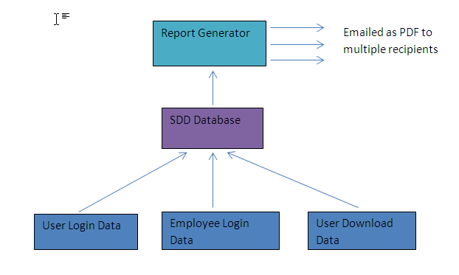
SDD Report Module
2 parts to reporting
Report generation
Email the report
Report Generation
Use of Crystal Report for generating reports
Use Crystal report Wizard to create the report design
Plug in the SQL query into the report
Export as PDF into a temporary folder

Slide 12
SDD Report Module(Contd…)
Email to User
Get list of report recipients and their email from database
Use C#’s email interface to create a message with reports as attachments
Send the email using SMTP

Slide 13
SDD Report Module Design
Features:
Email reports to users specified in database
Email frequency defined by the database.
What tools is used to generate reporting.
Email code example
Lessons learnt

Slide 14
Next Steps
Integrating the discovery website.
Developing the control panel.
Testing
Building the deployment guide
Product Delivery

